Slide 1

Wireless Network
PMIT-6217
By-
Dr. Jesmin Akhter
Professor
Institute of Information Technology
Jahangirnagar University

Slide 2
Contents
The course will mainly cover the following topics:
Wireless Networking
Multiple Access techniques for wireless Communications
Modulation Techniques for mobile radio
The Cellular Concepts

Slide 3
Outline
Wireless Networking
Wireless LAN Technologies
Wireless Link Characteristics
Mobile Ad-Hoc Networks
Wireless Sensor Networks
Major Problems with Wireless network
System Examples And Design Issues
Multiple Access Techniques
FDMA, TDMA and CDMA systems.

Slide 4
Wireless LAN Technologies
Wireless LAN technologies can be classified into four types:
Infrared
Narrowband RF
Spread-spectrum
Home RF and Bluetooth.

Slide 5
Infrared LANs
Each signal-covering cell in an infrared LAN is limited to one room. Coverage is small, since the infrared rays cannot penetrate through wall and other opaque obstacles. The primary difference between infrared and radio wireless LANs is the frequency of the transmitted signal. 802.11a and 802.11b operate in the 2.4 and 5GHz bands respectively, but infrared systems use frequencies in the terahertz range.
Notes:
Infrared at 1 Mbps and 2Mbps operates at wavelength between 850nm and 950nm.
The primary difference between infrared and radio wireless LANs is the frequency of the transmitted signal. 802.11a and 802.11b operate in the 2.4 and 5GHz bands respectively, but infrared systems use frequencies in the terahertz range. This places infrared signals in the light region invisible to the human eye and beyond the control of the Federal Communications Commission (FCC).
Omnidirectional antenna, an antenna that radiates equally in all directions. omnidirectional
Diffuse mean spread out, or the action of spreading out.

Slide 6
Infrared LANs
Three alternative transmission techniques are used for infrared data transmission:
Direct beam (point-to-point connection): Like a vehicle head light illuminates the road. The most familiar direct infrared communication device is the TV remote control. Another wireless input and control devices, such as wireless mice, wireless game controllers, and remote electronic keys. High gain directional antennas can transmit and receive wireless signals for several miles given clear line of sight and sufficient transmit power like building-to-building connections for high-speed network access or metropolitan- or campus-area networks.,
Omnidirectional configuration: Consists of a single BS that is normally used on ceilings providing 360⁰ donut shaped radiation pattern to provide the widest possible signal coverage in indoor and outdoor wireless applications,
Diffused configuration The transmitter directs the signal to a diffused reflecting ceiling. The signal is reflected in all directions from the ceiling in much the same way as a conventional light bulb illuminates a room . The infrared signal bounces off the walls and ceiling so that a receiver can pick up the signal regardless of orientation. These systems are well suited to the wireless LAN application, freeing the user from knowing and aligning with the locations of the other communicating devices.

Slide 7
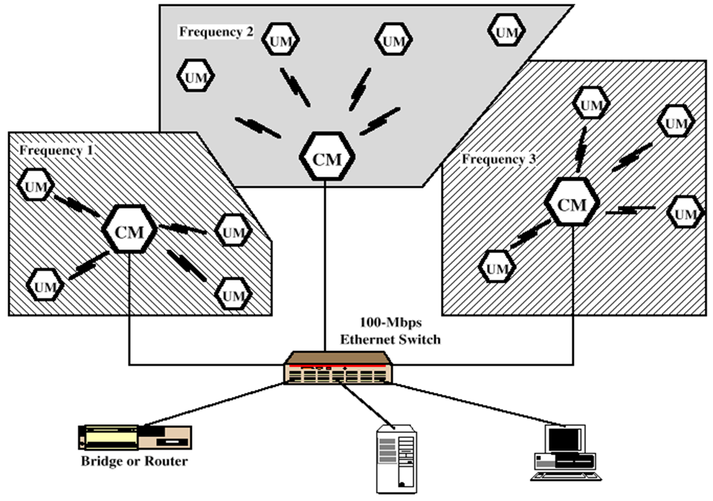
Narrowband RF LANs
Narrowband RF LANs use very narrow bandwidth.
Adjacent cells use different frequency bands.
The transmissions are encrypted to prevent attacks.
There are several Control Module (CM) to interface wireless LAN to the backbone Ethernet (wired LAN).
In the figure each cell has its own CM and connected by a switch to route traffic among them.
UM→ User Module
Notes:
Narrowband is usually considered to cover frequencies 300–3400 Hz.
Narrowband Microwave LANs: Licensed Narrowband RF Licensed narrowband LAN guarantees interference-free communication
UnLicensed Narrowband RF This spectrum can be used for narrowband transmission at low power (<0.5 W). The product operates at 10 Mbps in the 5.8 GHz band and has a range of 50 m in a semi-open office and 100 m in an open office.
Wired Equivalent Privacy (WEP) - a low-level data encryption system – was invented for wireless security purposes. WEP protocol protects link level data during wireless transmission between clients and access points. It does not provide end-to-end security, but only for the wireless portion of the connection

Slide 8
Narrowband RF LANs
Use of a microwave radio frequency band for signal transmission
Relatively narrow bandwidth
Licensed:
Licensed within specific geographic areas to avoid potential interference
Motorola - 600 licenses in 18-GHz range
Covers all metropolitan areas
Can assure that independent LANs in nearby locations don’t interfere
Encrypted transmissions prevent eavesdropping
Unlicensed
RadioLAN introduced narrowband wireless LAN in 1995
Used at low power (0.5 watts or less)
Operates at 10 Mbps in the 5.8-GHz band
Range = 50 m to 100 m
Uses unlicensed ISM spectrum (The ISM radio bands are portions of the radio spectrum reserved internationally for industrial, scientific and medical (ISM) purposes other than telecommunications. Examples include radio-frequency process heating, microwave ovens, and medical diathermy machines to apply deep heating to the body for relaxation and healing.)
Notes:
Microwaves are a form of electromagnetic radiation with wavelengths ranging from about one meter to one millimeter;
with frequencies between 300 MHz (1 m) and 300 GHz (1 mm)
The ISM radio bands are portions of the radio spectrum reserved internationally for industrial, scientific and medical (ISM) purposes other than telecommunications. Examples include radio-frequency process heating, microwave ovens, and medical diathermy machines. The powerful emissions of these devices
can create electromagnetic interference and disrupt radio communication using the same frequency, so these devices are limited to certain bands of frequencies

Slide 9
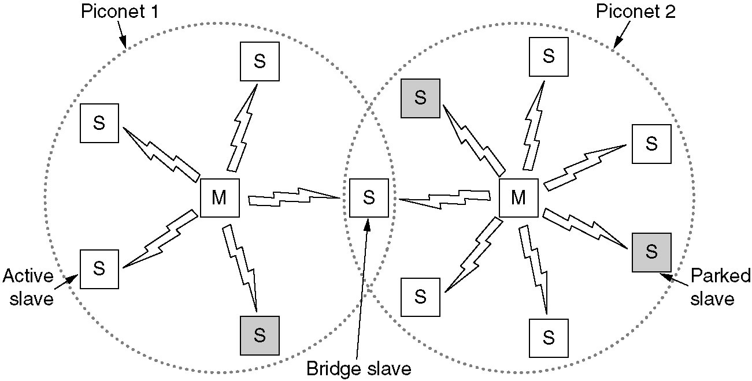
Home RF and Bluetooth
Home RF supports data rates of about 2Mbps and has range of about 50m.
Bluetooth is a wireless LAN technology designed to connect devices of different functions such as telephone, notebooks, computers, cameras, printers etc.
Bluetooth defines two types of networks called: piconet and scatternet.
A piconet can have up to eight stations, one of which is called primary station, the rest are called secondaries. All the secondary stations synchronize their clocks and hopping sequence with the primary. Bluetooth uses frequency-hopping spread spectrum (FHSS) in the physical layer to avoid interference from other devices or network.
Notes:
Piconets have a 7 member address space (3 bits, with zero reserved for broadcast), which limits the maximum size of a piconet to 8 devices, i.e. 1 master and 7 slaves.
A scatternet is a number of interconnected piconets that supports communication between more than 8 devices. Scatternets can be formed when a member of one piconet (either the master or one of the slaves) elects to participate as a slave in a second, separate piconet. The device participating in both piconets can relay data between members of both ad hoc networks. However, the basic Bluetooth protocol does not support this relaying - the host software of each device would need to manage it. Using this approach, it is possible to join together numerous piconets into a large scatternet, and to expand the physical size of the network beyond Bluetooth's limited range.
Currently there are very few actual implementations of scatternets due to limitations of Bluetooth and the MAC address protocol. However, there is a growing body of research being conducted with the goal of developing algorithms to efficiently form scatternets.
A number of companies have attempted to launch social networking and dating services that leverage early scatternet implementations (see Bluedating). Scatternets can also be used to enable ad hoc communication and interaction between autonomous robots and other devices.

Slide 10
Piconets can be combined to form scatternet where a secondary user of one piconet acts as bridge to another piconet. The bridge secondary/slave acts as a primary in receiving packets from the original primary of first piconet then deliver the packet to secondaries of the second piconet.
Although a piconet can have maximum 7 secondaries , additional secondaries can be in parked state. A seconadry in parked state is synchronized with the primary, but can not take part in communication until it is removed from parked state to the active state.
Notes:
Let's say you have a typical modern living room with typical modern stuff inside. There's an entertainment system with a stereo, a DVD player, a satellite TV receiver and a television; there's also a cordless telephone and a personal computer. Each of these systems uses Bluetooth, and each forms its own piconet to talk between the main unit and peripheral.

Slide 11
Two types of links can be created between primary and secondary:
A synchronous connection-oriented (SCO) link is used when avoiding latency (delay in data delivery) is more important than integrity (error free delivery) for example real time audio. If a packet is damaged it is never retransmitted.
An asynchronous connectionless link (ACL) is used when data integrity is more important than avoiding latency. In this type link if payload encapsulated in the frame is lost/ corrupted, it is retransmitted.

Slide 12
Layers of Bluetooth
Application Layer
L2CAL layer
Baseband layer
Radio Layer
Radio layer is like physical layer of Internet. Uses FHSS, GFSK modulation.
Baseband waveform is passed through a Gaussian filter to make the transitions smoother so to limit its spectral width.
Baseband layer is like MAC sublayer uses TDMA slot as the physical channel.
Time-division multiple access (TDMA) is a channel access method for shared-medium networks.
It allows several users to share the same frequency channel by dividing the signal into different time slots.
The users transmit in rapid succession, one after the other, each using its own time slot.
Logical Link Control and Adaption Protocol (L2CAP) is like LLC sublayer.
The LLC layer is concerned with managing traffic (flow and error control) over the physical medium
Applications Layer − This includes the application profiles that allow the user to interact with the Bluetooth applications.
Notes:
A GFSK modulator differs from a simple frequency-shift keying modulator in that before the baseband waveform (levels −1 and +1) goes into the FSK modulator, it is passed through a Gaussian filter to make the transitions smoother so to limit its spectral width.
Time-division multiple access (TDMA) is a channel access method for shared-medium networks. It allows several users to share the same frequency channel by dividing the signal into different time slots. The users transmit in rapid succession, one after the other, each using its own time slot.
The LCL layer is concerned with managing traffic (flow and error control) over the physical medium. The LCL layer also identifies a line protocol, such as SDLC, NetBIOS, or NetWare, and may also assign sequence numbers to frames and track acknowledgements. It accepts packets up to 64 kB from upper layer and breaks into frames for transmission.
LLC, that interacts with the Application layer above and the lower sub-layer, termed as MAC, that interacts with the physical layer below.
LLC, that interacts with the network layer above and the lower sub-layer, termed as MAC, that interacts with the physical layer below

Slide 13
Wireless Link Characteristics
important differences from wired link ….
decreased signal strength: radio signal attenuates as it propagates through matter (e.g., a radio signal passing through a wall). Even in free space, the signal will disperse, resulting in decreased signal strength (sometimes referred to as path loss) as the distance between sender and receiver increases.
interference from other sources: standardized wireless frequencies (e.g., 2.4 GHz) shared by other devices (e.g., phone); devices (motors, a microwave) interfere as well
multipath propagation: radio signal reflects off objects/ground, reaching destination at slightly different times as it takes paths of different lengths between a sender and receiver. This results in the blurring of the received signal at the receiver. Moving objects between the sender and receiver can cause multipath propagation to change over time.
Bit errors will be more common in wireless links than in wired links which make communication across (even a point to point) wireless link much more “difficult”
Notes:
In wireless telecommunications, multipath is the propagation phenomenon that results
in radio signals reaching the receiving antenna by two or more paths. Causes
of multipath include atmospheric ducting, ionospheric reflection and refraction, and
reflection from water bodies and terrestrial objects such as mountains and buildings.
The effects of multipath include constructive and destructive interference, and phase
shifting of the signal. In digital radio communications (such as GSM) multipath can
cause errors and affect the quality of communications.
Electrical interference: Appliances like air conditioners, heavy motors, x-ray machines and even sometimes hair driers and electric heaters can interfere with the WiFi signal. ... Weather / Environmental Interference: Lightening can disrupt RF signals totally, heavy rain and fog also dampen the signal distance and quality.

Slide 14
Wireless Link Characteristics
SNR: signal-to-noise ratio
This host receives an electromagnetic signal that is a combination of a degraded form of the original signal transmitted by the sender (degraded due to the attenuation and multipath propagation effects) and background noise in the environment. The signal-to-noise ratio (SNR) is a relative measure of the strength of the received signal (i.e., the information being transmitted) and this noise. The SNR is typically measured in units of decibels (dB).
larger SNR – easier to extract signal from noise (a “good thing”)

Slide 15
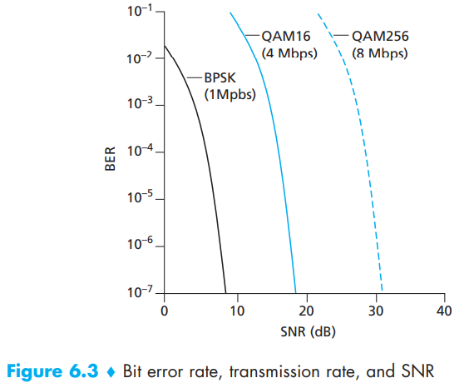
Wireless Link Characteristics: Physical-layer characteristics
Figure shows the bit error rate (BER)—The probability that a transmitted bit is received in error at the receiver—versus the SNR for three different modulation techniques for encoding information for transmission on an idealized wireless channel.

Slide 16
Wireless Link Characteristics: Physical-layer characteristics
For a given modulation scheme, the higher the SNR, the lower the BER. Since a sender can increase the SNR by increasing its transmission power, a sender can decrease the probability that a frame is received in error by increasing its transmission power
There are also disadvantages associated with increasing the transmission power:
More energy must be expended by the sender (an important concern for battery-powered mobile users), and the sender’s transmissions are more likely to interfere with the transmissions of another sender.
Notes:
. Note, however, that there is arguably little practical gain in increasing the power beyond a certain threshold,

Slide 17
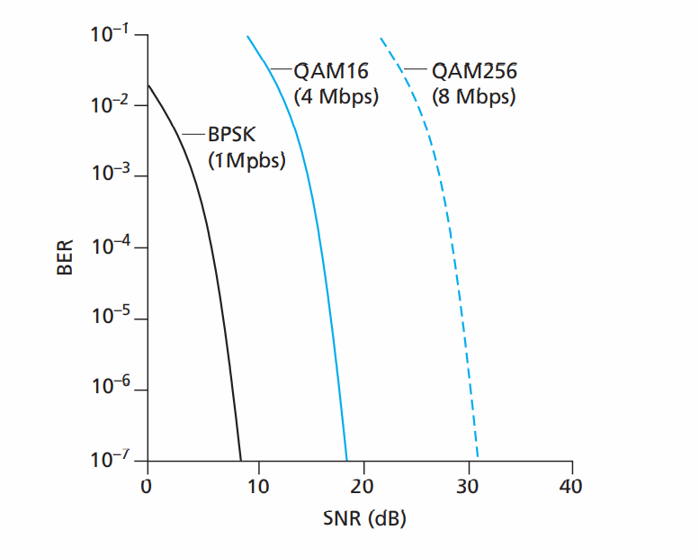

Slide 18
Wireless Link Characteristics: Physical-layer characteristics
For a given SNR, a modulation technique with a higher bit transmission rate (whether in error or not) will have a higher BER. For example, in with an SNR of 10 dB, BPSK modulation with a transmission rate of 1 Mbps has a BER of less than 10⁻⁷, while with QAM16 modulation with a transmission rate of 4 Mbps, the BER is 10⁻¹, far too high. However, with an SNR of 20 dB, QAM16 modulation has a transmission rate of 4 Mbps and a BER of 10⁻⁷, while BPSK modulation has a transmission rate of only 1 Mbps and a BER that is so low as to be (literally) “off the charts.”
Dynamic selection of the physical-layer modulation technique can be used to adapt the modulation technique to channel conditions. The SNR (and hence the BER) may change as a result of mobility or due to changes in the environment. Adaptive modulation and coding are used in cellular data systems and in the 802.11 WiFi and 3G cellular data networks. This allows, for example, the selection of a modulation technique that provides the highest transmission rate possible subject to a constraint on the BER, for given channel characteristics.

Slide 19


Wireless Link Characteristics: Physical-layer characteristics
A higher and time-varying bit error rate is not the only difference between a wired and wireless link. Recall that in the case of wired broadcast links, all nodes receive the transmissions from all other nodes. In the case of wireless links, the situation is not as simple. Multiple wireless senders and receivers create additional problems:
A
B
C
C
A’s signal
strength
C’s signal
strength
B
A
Hidden terminal problem
B, A hear each other
B, C hear each other
A, C can not hear each other means A, C unaware of their interference at B
space
Signal attenuation:
B, A hear each other
B, C hear each other
A, C can not hear each other interfering at B

Slide 20
Overview of Wireless Ad-Hoc Networks
Wireless mobile ad-hoc network (MANET) technology is designed for the establishment of a network anywhere and anytime, without any fixed infrastructure to support the mobility of the users in the network.
In other words, a wireless ad-hoc network is a collection of mobile nodes with a dynamic network infrastructure forming a temporary network. Such networks no central server or base station for providing connectivity, and all network intelligence must be placed inside the mobile user devices.

Slide 21
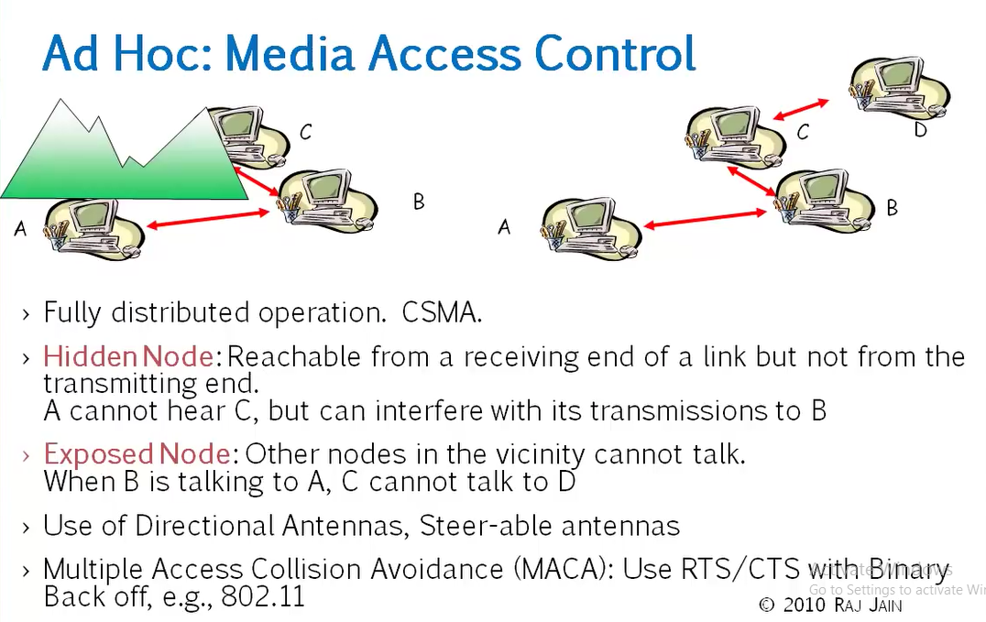

Slide 22
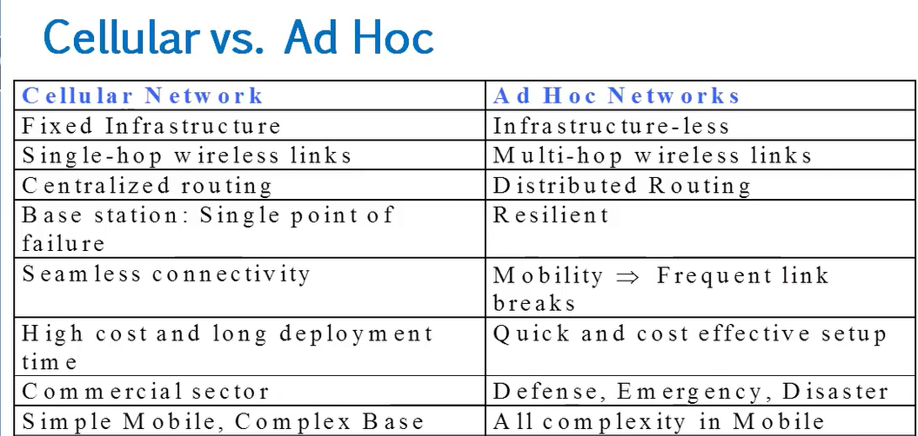

Slide 23
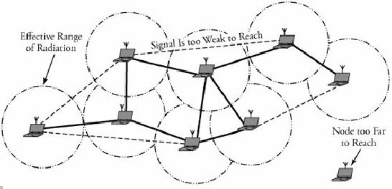
Fig.1gives overview of an ad-hoc network, where wireless mobile nodes have formed a network, with one node too far to reach.
Fig.1 Overview of Ad-Hoc Networks

Slide 24
In such an environment, each mobile user acts as a routing node, and a packet is routed from a source to its destination by incorporating of other network users.
Since the topology of an ad-hoc network can change quickly and unpredictably, it should be adaptable to changes, such as when a link breaks, a node leaves the network, or a new node is attached to the network.
Thus, unlike intra domain routing algorithm for regular networks, if a node leaves an ad-hoc network, all affected nodes can discover new routes.

Slide 25
Applications
Ad-hoc networks have several types of applications
Rescue operations. In an emergency public disaster, such as an earthquake, ad-hoc networks can be set up at a location where no infrastructure is present. Ad-hoc networks can be used to support network connectivity when no fixed network is available.
Military. Ad-hoc networks can be used in a battle zone, for a military command and mobile units.
Law enforcement and security operations. An ad-hoc network can be used in a temporary security operation, acting as a mobile surveillance network.
Home networks. An ad-hoc network can be used to support seamless (continuous) connectivity among various devices.
Conferencing. Ad-hoc networks can be set up for a presentation. An audience can download a presentation, browse the slides on a portable device, print them on the local printer, or e-mail the presentation to an absent colleague.

Slide 26
Routing in Ad-Hoc Networks
The lack of a backbone infrastructure makes packet routing in ad-hoc networks a challenging task. A routing protocol should be able to automatically recover from any problem in a finite amount of time without human intervention.
Identification of mobile terminals and correct routing of packets to and from each terminal while moving are certainly challenging. Here we will consider two routing protocols:
1. Destination-Sequenced Distance Vector (DSDV) Protocol
2. Cluster-Head Gateway Switch Routing Protocol

Slide 27
The Destination-Sequenced Distance Vector (DSDV) protocol is a table-driven routing protocol
Routing Tables
In addition to the destination address and next hop address, routing tables maintain the route metric (for example number of hops) and the route sequence number.
Periodically, or immediately when network topology changes are detected, each node will broadcast a routing table update packet. The update packet starts out with a metric of one. This signifies to each receiving neighbor they are one hop away from the node. The neighbors will increment this metric (in this case, to two) and then retransmit the update packet.
This process repeats itself until every node in the network has received a copy of the update packet with a corresponding metric. If a node receives duplicate update packets, the node will only pay attention to the update packet with the smallest metric and ignore the rest.

Slide 28
DSDV Packet Process Algorithm
To distinguish state update packets from valid ones, each update packet is tagged by the original node with a sequence number. The sequence number is a monotonically increasing number which uniquely identifies each update packet from a given node.
Consequently, if a node receives an update packet from another node, the sequence number must be equal to or greater than the sequence number already in the routing table
If the new address has a higher sequence number, the node chooses the route with the higher sequence number and discards the old sequence number.
If the incoming sequence number is identical to the one belonging to the existing route, a route with the least cost metric is chosen.

Slide 29
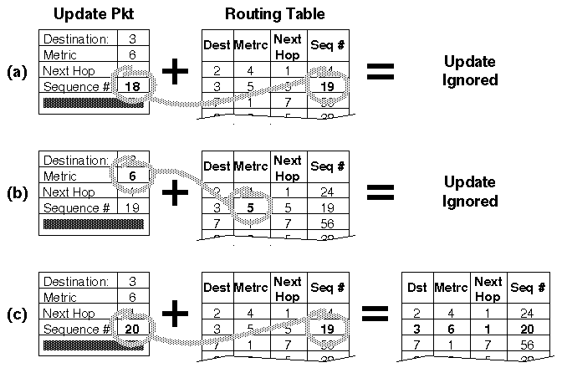
Fig.5 : A node receiving three update packets

Slide 30
The packet overhead of the DSDV protocol increases as the total number of nodes increases in the ad-hoc network. This fact makes DSDV suitable for small networks. In large ad-hoc networks, the mobility rate and therefore the overhead increase, making the network unstable to the point that updated packets might not reach nodes on time.

Slide 31
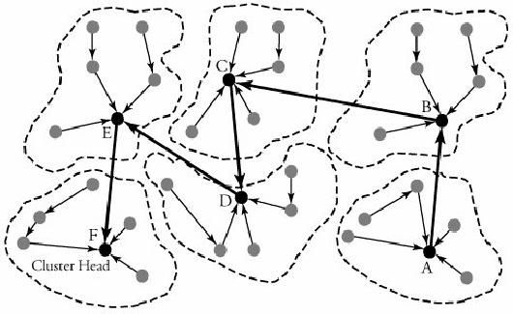
2. Cluster-Head Gateway Switch Routing Protocol
The Cluster-Head Gateway Switch Routing (CGSR) protocol is a table-driven routing protocol. In a clustering system each predefined number of nodes are formed into a cluster controlled by a cluster head, which is assigned using a distributed clustering algorithm.

Slide 32
However, with the clustering scheme, a cluster head can be replaced frequently by another node, for several reasons, such as lower-level energy left in the node or a node moves out of contact.
With this protocol, each node maintains two tables: a cluster-member table and a routing table. The cluster-member table records the cluster head for each destination node, and the routing table contains the next hop to reach the destination.

Slide 33
Fig.7 shows an example of routing in an area in which six clusters have been formed. A node in cluster A is transmitting a packet to a node in cluster F.
Nodes within each cluster route their packets to their own associated clusters. The transmitting node then sends its packet to the next hop, according to the routing table entry associated with that cluster head. The cluster head transmits the packet to another cluster head until the cluster head of the destination node is reached.
Fig.3 Communication with cluster head gateway switch routing (CGSR) protocol

Slide 34
Wireless Sensor Networks

Slide 35
Definition
A sensor network is an infrastructure comprised of sensing (measuring), computing, and communication elements. The results acquired by a regional network is provided to the administrator.
The administrator observe and react to events/phenomena in a specified environment. The administrator typically is a civil, governmental, commercial, or industrial entity.
The environment can be the physical world (temperature, pressure, sound), a biological system (biological and chemical sensors for national security applications for example Air pollution monitoring, Water quality monitoring) or an information technology (IT) framework.

Slide 36
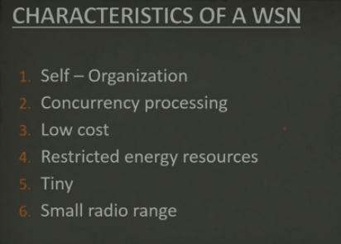

Slide 37
Applications
A wide-range of applications offered by WSN, some of these are environmental monitoring, industrial sensing, infrastructure protection, battlefield awareness and temperature sensing.
A short list of applications follows.
Military applications
Monitoring inimical forces
Monitoring friendly forces and equipment
Military-theater or battlefield surveillance
Targeting
Battle damage assessment
Nuclear, biological, and chemical attack detection
and more . . .

Slide 38
Environmental applications
Microclimates
Forest fire detection
Flood detection
Precision agriculture
and more . . .
Health applications
Remote monitoring of physiological data
Tracking and monitoring doctors and patients inside a hospital
Drug administration
Elderly assistance
and more . . .

Slide 39
Home applications
Home automation
Instrumented environment
Automated meter reading
and more . . .
Commercial applications
Environmental control in industrial and office buildings
Inventory control
Vehicle tracking and detection
Traffic flow surveillance
and more . . .

Slide 40
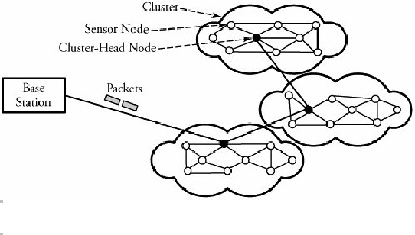
Infrastructure of Sensor Networks
The region being sensed is normally partitioned into equally loaded clusters of sensor nodes, as shown in Figure 2. A cluster in a sensor network resembles a domain in a computer network. In other words, nodes are inserted in the vicinity of a certain predefined region, forming a cluster. Different types of sensors can also be deployed in a region.
In Figure 2, three clusters are interconnected to the main base station, each cluster contains a cluster head responsible for routing data from its corresponding cluster to a base station.
Figure 2. A sensor network and its clusters

Slide 41
The wireless sensor node is equipped with a limited power source, such as a battery or even a solar cell, where there is enough sun light exposure on the node. However, a solar cell may not be the best choice as a power supply, owing to its weight, volume, and expense. In some application scenarios, sensor-node lifetime depends on the battery lifetime.

Slide 42
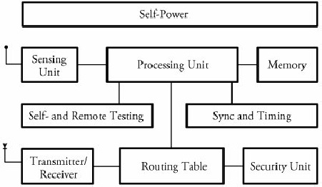
Sensor Node Structure
Figure 3 shows a typical sensor node. A node consists mainly of 3 components: sensing unit, a processing unit and memory, a self-power unit.
Other supporting components are: wireless transceiver component, as well as a self- and remote-testing unit, a synchronizing and timing unit, a routing table, and security units.
Each node must determine its location. This task is carried out by a location-finding system based on the global positioning system (GPS).
Fig.3 A typical wireless sensor node

Slide 43
Sensing Unit
The sensing unit consists of a sensor and an analog-to-digital converter. A smart sensor node consists of a combination of multiple sensors.
The analog signals produced by the sensors, based on the observed event, are converted to digital signals by the converter and then fed into the processing unit.

Slide 44
Processing and Memory Unit
The processing unit performs certain computations on the data and, depending on how it is programmed, may send the resulting information out to the network.
The processing unit, which is generally associated with memory, manages the procedures that make the sensor node collaborate with the other nodes to carry out the assigned sensing task.
The central processor determines what data needs to be analyzed, stored, or compared with the data stored in memory.

Slide 45
Self-Power Unit
A sensor node is supposed to be mounted in a small physical unit, limiting space for the battery. Moreover, the random distribution of sensors makes it impossible to periodically recharge or exchange batteries.
In most types of sensor networks, the power unit in a sensor node is the most important unit of the node because the liveliness and existence of a node depend on the energy left in the node, and the routing in the sensor network is based on the algorithm that finds a path with the least energy.
Thus, it is essential to use energy-efficient algorithms to prolong the life of sensor networks. The main task of the sensor node is to identify events, to process data, and then to transmit the data. The power of a node is consumed mainly in the transmitter and receiver unit.
The sensor node can be supplied by a self-power unit, self-power unit battery, or solar cells

Slide 46
Clustering Protocols
Clustering Protocols specify the topology of the hierarchical non-overlapping cluster nodes.
An efficient Clustering Protocol ensures the creation of clusters with almost the same radius and cluster heads that are the best positioned in the cluster.
Since every node in a cluster network is connected to cluster head, route discovery among cluster heads is sufficient to establish a feasible route in the network.

Slide 47
Classification of Clustering Protocols
Clustering techniques can be either centralized or decentralized.
Centralized clustering algorithms require each sensor node to send its individual information, such as energy level and geographical position, to the central base station. Based on a predefined algorithm, a base station calculates the number of clusters, their sizes, and the cluster heads' positions and then provides each node with its newly assigned duty.

Slide 48
Decentralized clustering techniques create clusters without the help of any centralized base station. An energy-efficient and hierarchical clustering algorithm can be such a way whereby each sensor node becomes a cluster head with a probability of p and advertises its candidacy to nodes that are no more than k hops away from the cluster head.
The Low-Energy Adaptive Clustering Hierarchy (LEACH) algorithm and the Decentralized Energy-Efficient Cluster Propagation (DEEP) protocol are two examples of the decentralized clustering protocols.

Slide 49
LEACH Clustering Protocol
The Low-Energy Adaptive Clustering Hierarchy (LEACH) is an application-specific protocol architecture that aims to prolong network lifetime by periodic re-clustering and change of the network topology.
LEACH is divided into rounds consisting of a clustering phase and a steady-state phase for data collection. At the start of each round, a sensor node randomly chooses a number between 0 and 1 and then compares this number to a calculated threshold called T(n). If T(n) is larger than the chosen number, the node becomes a cluster head for the current round. The value T(n) is calculated using the following formula:

Slide 50
r=0:15;
p=1/16;
Tn =p./(1-p*(mod(r,1/p)));
plot(r,Tn, 'b>-')
xlabel('r')
ylabel('T(n)')
grid on
r = 0 1 2 3 4 5 6 7 8 9 10 11 12 13 14 15
T_{n} = 0.0625 0.0667 0.0714 0.0769 0.0833 0.0909 0.1 0.1111 0.125 0.1429 0.1667 0.2 0.25 0.3333 0.5 1

Slide 51
where p is the ratio of the total number of cluster heads to the total number of nodes, r is the number of rounds, and G is a set of nodes that have not been chosen as cluster heads for the last 1/p rounds.
For the first round (r = 0), T(n) is equal to p, and nodes have an equal chance to become cluster head. As r gets closer to 1/p, T(n) increases, and nodes that have not been selected as cluster head in the last 1/p rounds have more chance to become cluster head.

Slide 52
After 1/p - 1 rounds, T(n) is equal to 1, meaning that all the remaining nodes have been selected as cluster head. Thus, after 1/p rounds, all the nodes have had a chance to become a cluster head once. Since being the cluster head puts a substantial burden on the sensor nodes, this ensures that the network has no overloaded node that runs out of energy sooner than the others.

Slide 53
After cluster heads are self-selected, they start to advertise their candidacy to the other sensor nodes.
When a node receives advertisements from more than one cluster-head, chooses the candidate whose associated signal is received with higher power. This ensures that sensor node chooses the closest candidates as cluster head.

Slide 54
2. DEEP Clustering Protocol
The Decentralized Energy-Efficient Cluster Propagation (DEEP) protocol that establishes clusters with uniformly distributed cluster heads. This protocol balances the load among all the cluster heads by keeping the clusters' radii fairly equal. This protocol is completely decentralized, and there is no need for any location-finder device or hardware.
The protocol starts with an initial cluster head and forms new cluster-head candidates gradually by controlling the relative distance between a pair of cluster heads and the circular radius of each cluster.

Slide 55
In order to avoid the frequent control signal transmission and extra power consumption associated with that, a cluster head can be placed at the center of the cluster and cluster members can send the data packets directly to the cluster head without the need for any route set-up protocol.
In order to explain the details of this algorithm, control signals and protocol parameters need to be introduced:
Control signals: (1) cluster-head declaration signal or (2) cluster-head exploration signal
Membership search signal with control parameters: declaration range (d_{r}), exploration range (d_{r1}, d_{r2}), minimum number of members (m_{n}), the received signal energy (E_{rc1} and E_{rc2}).

Slide 56
Begin DEEP Clustering Algorithm
Initial cluster head finds cluster members by sending "cluster-head declaration.”
Initial cluster head finds new cluster-head candidates by sending "cluster-head exploration signal.”
Repeat: Cluster-head candidates that are placed on the (d_{r1}, d_{r2}) ring find cluster members.
Nodes that receive more than one cluster-head declaration choose the closest cluster head, based on the received signal energy.
Cluster-head candidates that receive a cluster-head declaration signal negotiate with the sender, and one of them gets eliminated.
Confirmed cluster heads send "cluster-head exploration" signals to find new cluster-head candidates(Go to step 4).
Finalize: If the number of members in a cluster is less than m_{n}, all the members find new clusters by sending the membership-search signal.
At the end, a node that has not received any control signal sends the membership-search signal.

Slide 57
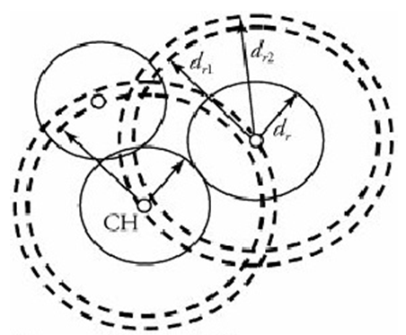

Slide 58
Major Problems with Wireless network

Slide 59
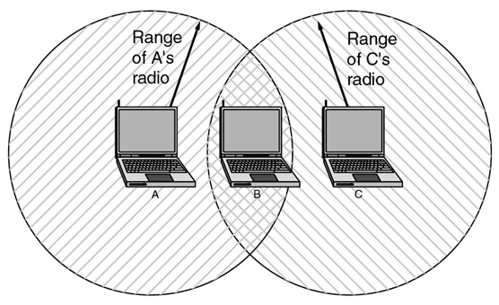
First Problem: A computer on Ethernet always listens to the ether before transmitting. Only if the ether is idle does the computer begin transmitting. With wireless LANs, that idea does not work so well. The range of a single radio may not cover the entire system
Suppose that computer A is transmitting to computer B (one way), but the radio range of A is too short to reach computer C. If C wants to transmit to B it can listen to the ether before starting, but the fact that it does not hear anything (since it is outside the coverage of A) does not mean that its transmission will succeed. The 802.11 standard had to solve this problem (CSMA/CA).
Notes:
IEEE 802.3-Ethernet -IEEE Protocol- wired computer networking technologies commonly used in local area networks (LAN), metropolitan area networks (MAN) and wide area networks (WAN)
Ethernet is a type of network cabling and signaling specifications developed by Xerox in the late 1970.
An Ethernet cable is one of the most popular forms of network cable used on wired networks.
The original 10BASE5 Ethernet uses coaxial cable as a shared medium, while the newer Ethernet variants use twisted pair and fiber optic links in conjunction with switches.

Slide 60
The problem we mentioned here is called Hidden Terminal Problem
A and B can hear each other. B and C can hear each other. But A and C cannot hear each other.
When A is sending data to B, C cannot sense this activity and hence C is allowed to send data to B at the same time. This will cause a collision at B.
collision
A
B
C
Consider the effect of RTS/CTS:
RTS/CTS (Request to Send / Clear to Send) is the optional mechanism used by the 802.11 wireless networking protocol to reduce frame collisions introduced by the hidden node problem.

Slide 61
Avoiding collisions
IEEE 802.11 at MAC sublayer uses CSMA/CA as the access method.
Standard 802.11 typically uses the carrier Sense Multiple Access with collision avoidance (CSMA/CA) method.
Carrier sense (CS) means: hardware capable of sensing whether transmission taking place in vicinity
With this method, each user listens for traffic coming from other users and transmits data if the channel is idle.

Slide 62
Carrier Sense Multiple Access/ Collision Avoidance (CSMA/CA)
The wireless LAN system cannot detect collisions because the power of the transmitting device is much stronger than the receiver’s power.
In this situation collision detection is not practical, it makes sense to try to device a system that can help prevent collisions. Thus the CA is CSMA/CA refers to ‘collision avoidance’.
In wired networks, if a collision has occurred then the energy of the received signal almost doubles, and the station can sense the possibility of collision. In the case of wireless networks, most of the energy is used for transmission, and the energy of the received signal increases by only 5-10% if a collision occurs. It can’t be used by the station to sense collision. Therefore CSMA/CA has been specially designed for wireless networks.

Slide 63
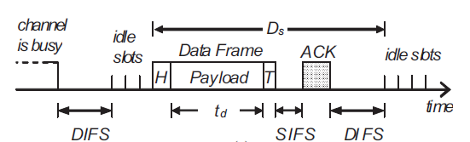
Distributed Binary Exponential Backoff Algorithm
To reduce the packet dropping probability or to enhance throughput of wireless LAN exponential binary backoff algorithm is widely used. The access method of MAC protocol of IEEE 802.11 based on exponential binary backoff algorithm can be explained with the following steps.
Step: 1
The transmitting node first senses the status of the channel. If the channel is found busy then the Tx node continues to monitor the channel.
Step:2
If the channel is found idle for a fixed duration known as DIFS (Distributed Inter-frame Space), the Tx chooses a random number according to the binary exponential back off algorithm. The random number is used as a back off timer.
Notes:
Carrier sense multiple access (CSMA) is a media access control (MAC) protocol in which a node verifies the absence of other traffic before transmitting on a shared transmission medium, such as an electrical bus, or a band of the electromagnetic spectrum.
Although CSMA/CA has been used in a variety of wired communication systems, it is particularly beneficial in a wireless LAN due to a common problem of multiple stations being able to see the Access Point, but not each other. This is due to differences in transmit power, and receive sensitivity, as well as distance, and location with respect to the AP.^{[5]} This will cause a station to not be able to 'hear' another station's broadcast. This is the so-called 'hidden node', or 'hidden station' problem. Devices utilizing 802.11 based standards can enjoy the benefits of collision avoidance (RTS / CTS handshake, also Point coordination function), although they do not do so by default. By default they use a Carrier sensing mechanism called 'exponential backoff', or (Distributed coordination function) that relies upon a station attempting to 'listen' for another station's broadcast before sending. CA, or PCF relies upon the AP (or the 'receiver' for Ad hoc networks) granting a station the exclusive right to transmit for a given period of time after requesting it (Request to Send / Clear to Send).^{[6]}

Slide 64
Step:3
Time immediately after the DIFS (Distributed Inter-frame Space) is slotted known as idle slots where the duration of a slot is considered as the sum of the time required to sense a station and to switch the Tx from sensing / listening mode to transmitting mode.
Step:4
Elapsing of each idle slot the back off timer is decreased by one. If the channel is found busy before the back off timer reaches to zero then repeat the steps 1 to 3. The transmission of data from begins only if the back off timer reaches to zero.
Notes:
The essential data that is being carried within a packet or other transmission unit.
First time if the media is free it will only wait for DIFS time, but if it is more than one time or sense busy then it will wait additionally for backoff time.

Slide 65
Step:5
To determine whether a data frame transmission is successful, after its completion, a positive acknowledgement (ACK) is transmitted by the receiver. ACK is transmitted after a short interframe space (SIFS) period upon receiving the entire data frame successfully.
If ACK is not detected within an SIFS period after the completion of the data frame transmission, the transmission is assumed to be unsuccessful, and a retransmission is required. Sender usually uses binary exponential backoff.

Slide 66
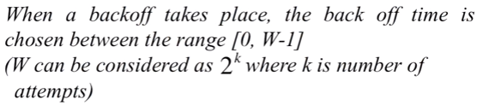

Slide 67
Avoiding collisions(more)
sender first transmits small request-to-send (RTS) packets to BS using CSMA
RTSs may still collide with each other (but they’re short)
BS broadcasts clear-to-send CTS in response to RTS
CTS heard by all nodes
sender transmits data frame
other stations defer transmissions
avoid data frame collisions completely
using small reservation packets!
Notes:
Unicast: one sends, one receives
Broadcasting: one sends, all receive
Multicasting: one sends, a group receives

Slide 68



Collision Avoidance: RTS-CTS exchange
A
B
AP
RTS(B)
RTS(A)
reservation collision
RTS(A)
CTS(A)
CTS(A)
DATA (A)
defer
time
ACK(A)
ACK(A)

Slide 69
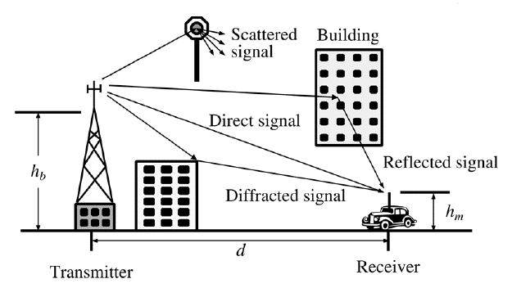
Second Problem:
In radio communication Multipath propagation (Multipath fading) due to presence of reflecting and refracting from water bodies and terrestrial objects such as mountains and buildings or even scatterers hence cause multiple versions of the signal arrive at the receiver through two or more paths.
Multipath propagation causes multipath interference, including constructive and destructive interference of the signal;
Destructive interference causes fading. This may cause a radio signal to become too weak in certain areas to be received adequately, so multipath propagation can be detrimental in radio communication systems.
Notes:
Multipath fading
A direct and Diffracted signal may or may not arrive at the received point in phase. Radio waves that are received in phase reinforce each other and produce a stronger signal at the receiving site, while those that are received out of phase produce a weak or fading signal. Small alterations in the transmission path may change the phase relationship of the two signals, causing periodic fading.
Signals are received in a terrestrial environment, i.e. where reflections are present and signals arrive at the receiver from the transmitter via a variety of paths. The overall signal received is the sum of all the signals appearing at the antenna. Sometimes these will be in phase with the main signal and will add to it, increasing its strength. At other times they will interfere with each other. This will result in the overall signal strength being reduced.

Slide 70
Small-scale fading, or simply fading, is used to describe the rapid fluctuations of the amplitudes, phases, or multipath delays of a radio signal over a short period of time or travel distance, so that large-scale path loss effects may be ignored. With small variation of distance and time cause wide variation of received signal experienced in a dense city.
Fading is caused by interference between two or more versions of the transmitted signal which arrive at the receiver at slightly different times. These waves, called multipath waves, combine at the receiver antenna to give a resultant signal which can vary widely in amplitude and phase, depending on the distribution of the intensity and relative propagation time of the waves and the bandwidth of the transmitted signal.
Notes:
Multipath fading
A direct and Diffracted signal may or may not arrive at the received point in phase. Radio waves that are received in phase reinforce each other and produce a stronger signal at the receiving site, while those that are received out of phase produce a weak or fading signal. Small alterations in the transmission path may change the phase relationship of the two signals, causing periodic fading.
Signals are received in a terrestrial environment, i.e. where reflections are present and signals arrive at the receiver from the transmitter via a variety of paths. The overall signal received is the sum of all the signals appearing at the antenna. Sometimes these will be in phase with the main signal and will add to it, increasing its strength. At other times they will interfere with each other. This will result in the overall signal strength being reduced.

Slide 71
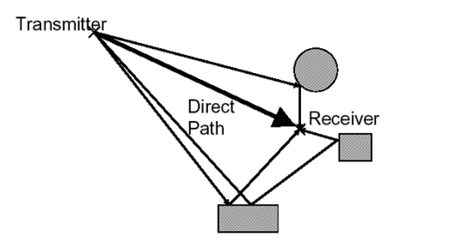
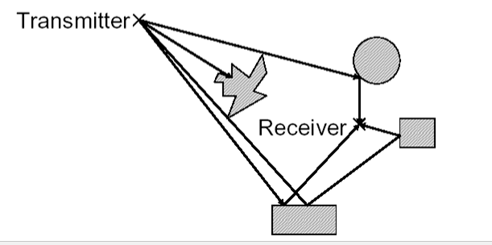
When the magnitudes of the signals are arrived by the various paths have a distribution known as the Rayleigh distribution and the fading is known as Rayleigh fading, where all the components are non-LOS:
i.e. there is no line-of–sight (LOS) component.
When one of the multipath components (a line of sight component) dominates, a Rician distribution provides a more accurate model, and this is known as Rician fading. i.e. there is one LOS component
Rayleigh fading
Rician fading
Notes:
Multipath fading
A direct and Diffracted signal may or may not arrive at the received point in phase. Radio waves that are received in phase reinforce each other and produce a stronger signal at the receiving site, while those that are received out of phase produce a weak or fading signal. Small alterations in the transmission path may change the phase relationship of the two signals, causing periodic fading.
Signals are received in a terrestrial environment, i.e. where reflections are present and signals arrive at the receiver from the transmitter via a variety of paths. The overall signal received is the sum of all the signals appearing at the antenna. Sometimes these will be in phase with the main signal and will add to it, increasing its strength. At other times they will interfere with each other. This will result in the overall signal strength being reduced.

Slide 72
FHSS inherently solves the multipath problem by simply hopping to other frequencies.
Other systems use anti-multipath algorithms to avoid this interference.
Notes:
Multipath fading
A direct and Diffracted signal may or may not arrive at the received point in phase. Radio waves that are received in phase reinforce each other and produce a stronger signal at the receiving site, while those that are received out of phase produce a weak or fading signal. Small alterations in the transmission path may change the phase relationship of the two signals, causing periodic fading.
Signals are received in a terrestrial environment, i.e. where reflections are present and signals arrive at the receiver from the transmitter via a variety of paths. The overall signal received is the sum of all the signals appearing at the antenna. Sometimes these will be in phase with the main signal and will add to it, increasing its strength. At other times they will interfere with each other. This will result in the overall signal strength being reduced.

Slide 73
Handoff Region
Third Problem: Handoff is necessary like mobile communications.
A well-implemented handoff is important for delivering uninterrupted service to a caller or data session user
Signal strength due to BS_{i}
Signal strength due to BS_{j}
P_{i}(x)
P_{j}(x)
E
P_{min}
BS_{i}
MS
BS_{j}
X₁
X₃
X₅
X_{th}
X₄
X₂
By looking at the variation of signal strength from either base station it is possible to decide on the optimum area where handoff can take place.
Notes:
A handoff refers to the process of transferring an active call or data session from one cell in a cellular network to another or from one channel in a cell to another.
In Europe and other countries, a handoff is known as a handover.

Slide 74
Fourth Problem: Some times software is not aware of mobility. For example many word processors have a list of printers that users can choose to print a file. When the computer on which the word processor runs is taken into a new environment, the built-in list of printer becomes invalid.

Slide 75
Carrier Sense Multiple Access/ Collision Detection (CSMA/CD)
Carrier-sense multiple access with collision detection (CSMA/CD) is a media access control (MAC) method used most notably in early Ethernet technology for local area networking.
It uses carrier-sensing to defer transmissions until no other stations are transmitting. This is used in combination with collision detection in which a transmitting station detects collisions by sensing transmissions from other stations while it is transmitting a frame.
When this collision condition is detected, the station stops transmitting that frame, transmits a jam signal, and then waits for a random time interval before trying to resend the frame.
CSMA/CD is a modification of pure carrier-sense multiple access (CSMA). CSMA/CD is used to improve CSMA performance by terminating transmission as soon as a collision is detected, thus shortening the time required before a retry can be attempted.

Slide 76
Carrier Sense Multiple Access/ Collision Detection (CSMA/CD)
A collision detection mechanism compares the amount of energy on the media after a packet is transmitted. If the value is greater than the energy used by the transmitting device, then a collision has occurred. If there is no difference the two measured values, then a collision has not occurred.

Slide 77
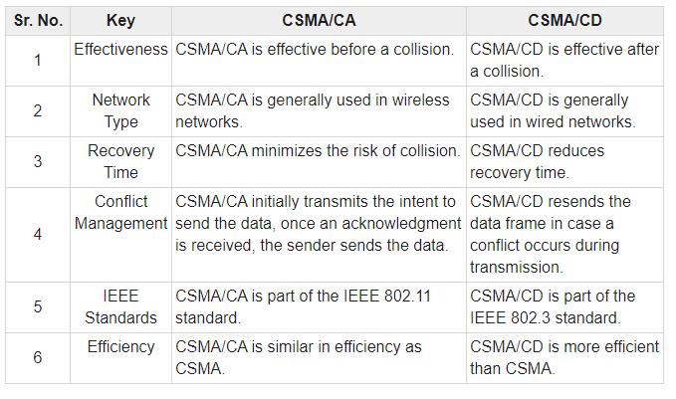
Notes:
intent

Slide 78
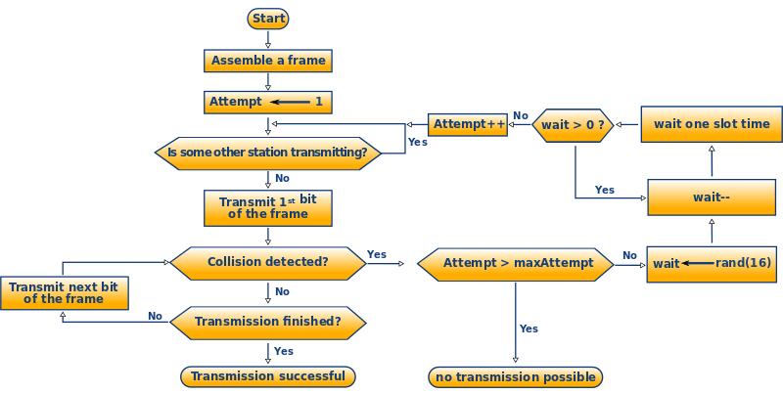
Flow Chart CSMA/CD-Algorithm

Slide 79
Multiple Access Techniques
Goal in the design of a cellular system to be able to handle as many calls as possible in a given bandwidth with the specified blocking probability.
Since the amount of spectrum available is limited, we need to find ways to allow multiple users to share the available spectrum simultaneously.
Multiple access schemes allow many users to share the radio spectrum.
Sharing the bandwidth efficiently among users is one of the main objectives of multiple access schemes
Notes:
Frequency spectrum of a signal is the range of frequencies contained by a signal
Frequency is the number of occurrences of a repeating event per unit of time.
Bandwidth is a range of frequencies within a given band, in particular that used for transmitting a signal

Slide 80
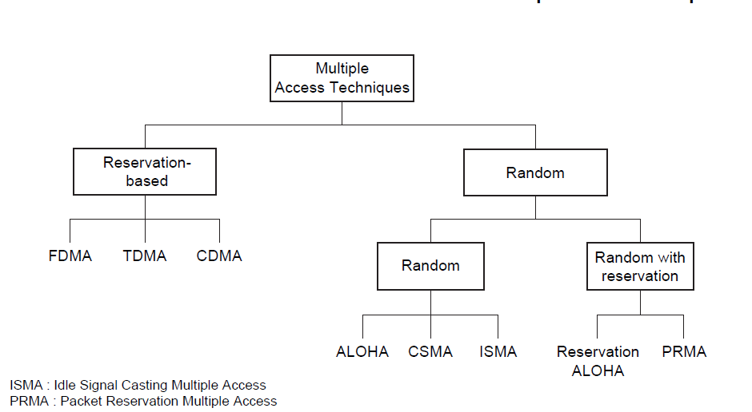
Classification: Multiple Access Techniques
Multiple access schemes can be classified as reservation-based multiple access (e.g., FDMA, TDMA, CDMA) and random multiple access (e.g., ALOHA, CSMA).

Slide 81
Multiple Access Techniques
If data traffic is continuous and a small transmission delay is required (for example in voice communication) reservation based multiple access is used.
the communication channel is based on FDMA, TDMA, or CDMA.
In many wireless systems for voice communication, the control channel is based on random multiple access
The reservation-based multiple access technique has a disadvantage in that once the channel is assigned, it remains idle if the user has nothing to transmit, while other users may have data waiting to be transmitted.
This problem is critical when data generation is random and has a high peak-rate to average-rate ratio.

Slide 82
Multiple Access Techniques
Random multiple access is more efficient, because a communication channel is shared by many users and users transmit their data in a random or partially coordinated fashion. ALOHA and carrier sense multiple access (CSMA) are examples of random multiple access.
If the data arrives in a random manner, and the data length is large, then random multiple access combined with a reservation protocol will perform better than both random- and reservation based schemes.

Slide 83
FDMA
Total system bandwidth is divided into narrow frequency slots.
FDMA assigns individual channels to individual users
A user is free to transmit or receive all the time on its allocated radio channel, but the cost of transceiver is high, as each has to be designed on a different band
Guard bands are maintained between adjacent signal spectra to minimize cross talk between channels
During the period of call no other user can share the same frequency band
Each user transmits with no limitations in time, but using only a portion of the whole available frequency bandwidth.
Different users are separated in the frequency domain
In frequency division duplex (FDD) systems, the users are assigned a channel as a pair of frequencies. One frequency is used for the upward channel, while the other frequency is used for the downward channel

Slide 84
FDMA-advantages
Capacity can be increased by reducing the information bit rate and using an efficient digital speech coding scheme
Technological advances required for implementation are simple. A system can be configured so that improvements in terms of a lower bit rate speech coding could be easily incorporated.
Hardware simplicity, because multiple users are isolated by employing simple bandpass filters.
Notes:
Speech coding is the process for reducing the bit rate of digital speech representation or transmission or storage, while maintaining a speech quality that is
acceptable for the application. Speech coding methods are classified as waveform coding, source coding, and hybrid coding.
The main function of bandpass filter in a transmitter is to limit the bandwidth of the output signal to the band allocated for the transmission. This prevents the transmitter from interfering with other stations.

Slide 85
FDMA-Disadvantages
FDMA wastes bandwidth. If an FDMA channel is not in use, then it sits idle and cannot be used by other users to increase or share capacity.
The FDMA mobile users unit uses duplexers since both the transmitter and receiver operate at the same time. A duplexers add weight, size and cost to a radio transmitter and can limit the minimum size of a subscriber unit
FDMA requires tight RF filtering to minimize adjacent channel interference
Notes:
RF filters are used within transmitters to ensure that unwanted or spurious signals are not transmitted

Slide 86
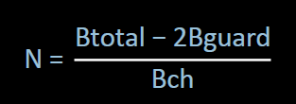
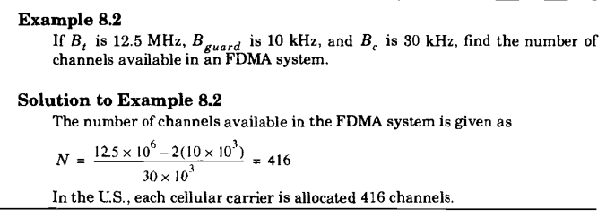
Numbers of Channels in FDMA
Let Btotal be the total system bandwidth, Bguard be the guard band at edge, and Bch the single radio channel bandwidth. Then the number of channels in a FDMA system:
Notes:
Rappaport Example

Slide 87
TDMA
In digital systems, continuous transmission is not required because users do not use the allotted bandwidth all the time. In such cases, TDMA is a complimentary access technique to FDMA.
In TDMA, the entire bandwidth is available to the user but only for a finite period of time. In most cases the available bandwidth is divided into fewer channels compared to FDMA and the users are allotted time slots during which they have the entire channel bandwidth at their disposal.
TDMA requires careful time synchronization since users share the bandwidth in the frequency domain.
The number of channels are less, inter channel interference is almost negligible.
TDMA uses different time slots for transmission and reception. This type of duplexing is referred to as Time division duplexing(TDD).

Slide 88
TDMA
Guard times are used between each user’s transmission to minimize cross talk between channels.
In a TDMA/TDD system, half of the time slots in the frame information message would be used for the forward link channels and half would be used for reverse link channels.
In TDMA/FDD systems, the carrier frequencies would be different for the forward and reverse links.
GSM (Global Systems for Mobile communications) uses a TDMA technique, where the carrier is 200 kHz wide and supports eight full rate channels.
A channel (roughly) consists of the recurrence every 4.6 ms of a time slot of 0.58 ms.

Slide 89
Features of TDMA
TDMA shares a single carrier frequency with several users where each users makes use of non overlapping time slots.
The number of time slots per frame depends on several factors such as modulation technique, available bandwidth etc.
Data transmission in TDMA is not continuous but occurs in bursts. This results in low battery consumption since the subscriber transmitter can be turned OFF when not in use. Because of a discontinuous transmission in TDMA the handoff process is much simpler for a subscriber unit, since it is able to listen to other base stations during idle time slots.
TDMA uses different time slots for transmission and reception thus duplexers are not required.
TDMA can be easily adapted to the transmission of data as well as voice communication.
TDMA has an advantage that is possible to allocate different numbers of time slots per frame to different users. Thus bandwidth can be supplied on demand to different users by concatenating or reassigning time slot based on priority.
Notes:
A burst is a transmission involving a large amount of data sent in a short time

Slide 90
Features of TDMA
Permits flexible rates (i.e. several slots can be assigned to a user, for example, each time interval translates 32Kbps, a user is assigned two 64 Kbps slots per frame).
Can withstand variable bit rate traffic. Number of slots allocated to a user can be changed frame by frame (for example, two slots in the frame 1, three slots in the frame 2, one slot in the frame 3, …etc.).
No guard band required for the wideband system.
No narrowband filter required for the wideband system.

Slide 91
Disadvantages
For mobiles and particularly for hand-sets, TDMA on the uplink demands high peak power in transmit mode, that shortens battery life.
TDMA requires a substantial amount of signal processing for matched filtering and correlation detection for synchronizing with a time slot.
TDMA requires synchronization. If the time slot synchronization is lost, the channels may collide with each other.
One complicating feature in a TDMA system is that the propagation time for a signal from a mobile station to a base station varies with its distance to the base station.

Slide 92
Number of channels in TDMA system
The number of TDMA channel slots that can be provided in a TDMA system is found by multiplying the number of TDMA slots per channel by the number of channels available and is given by
N = m(BTot — 2Bguard)/Bc
where m is the maximum number of TDMA users supported on each radio channel. Note that two guard bands, one at the low end of the allocated frequency band and one at the high end, are required to ensure that users at the edge of the band do not "bleed over" into an adjacent radio service.
Notes:
bleed over-contamination

Slide 93
Number of channels in TDMA system
Example 8.3
Consider Global System for Mobile, which is a TDMA/FDD system that uses 25 MHz for the forward link, which is broken into radio channels of 200 kHz. If speech channels are supported on a single radio channel, and if no guard band is assumed, find the number of simultaneous users that can be accommodated in GSM.
Solution
The number of simultaneous users that can be accommodated in GSM is given as
N =8*25MHz/(200 kHz)
=1000
Thus, GSM can accommodate 1000 simultaneous users.
Notes:
Rappaport Example

Slide 94
Example 8.4
If GSM uses a frame structure where each frame consists of 8 time slots, and each time slot contains 156.25 bits, and data is transmitted at 270.833 kbps in the channel, find (a) the time duration of a bit, (b) the time duration of a slot, (c) the time duration of a frame, and (d) how long must a user occupying a single time slot must wait between two simultaneous transmissions.
Solution
The time duration of a bit, Tb = 1/270.833 kbps = 3.692 µs
The time duration of a slot, TSlot= 156.25 x Tb = 0.577 ms.
(c) The time duration of a frame, Tf, = 8 x TSlot = 4.615 ms.
(d) A user has to wait 4.615 ms, the arrival time of a new frame, for its next transmission.

Slide 95
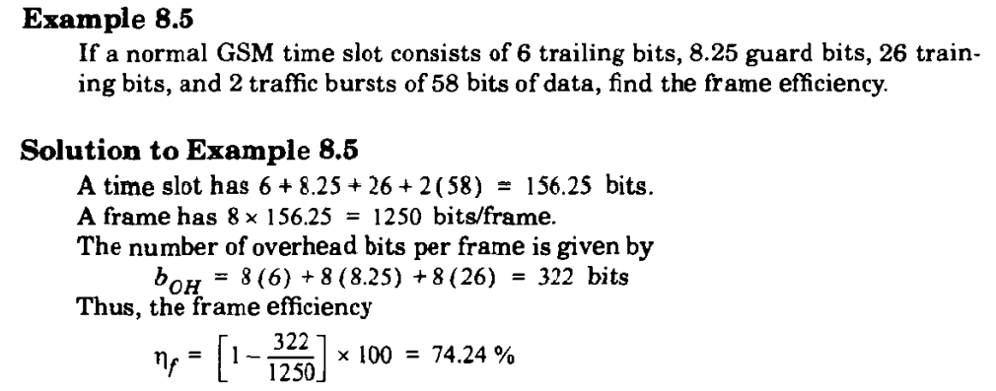

Slide 96
Spectral Efficiency
An efficient use of the spectrum is the most desirable feature of a mobile communications system. To realize this, a number of techniques have been proposed or already implemented. Some of these techniques used to improve spectral efficiency are reducing the channel bandwidth, information compression (low-rate speech coding), variable bit rate codec, improved channel assignment algorithms (dynamic channel assignment), and so on.
Spectral efficiency of a mobile communications system shows how efficiently the spectrum is used by the system. Spectral efficiency of a mobile communications system depends on the choice of a multiple access scheme.
The measure of spectral efficiency enables one to estimate the capacity of a mobile communications system.
The overall spectral efficiency of a mobile communications system can be estimated by knowing the modulation and the multiple access spectral efficiencies separately.

Slide 97
Multiple Access Spectral Efficiency
Multiple access spectral efficiency is defined as the ratio of the total time or frequency dedicated for traffic transmission to the total time or frequency available to the system.
The multiple access spectral efficiency is a dimensionless. In FDMA, users share the radio spectrum in the frequency domain.
In FDMA, the multiple access efficiency is reduced because of guard bands between channels and also because of signaling channels.
In TDMA, the efficiency is reduced because of guard time and synchronization sequence.

Slide 98
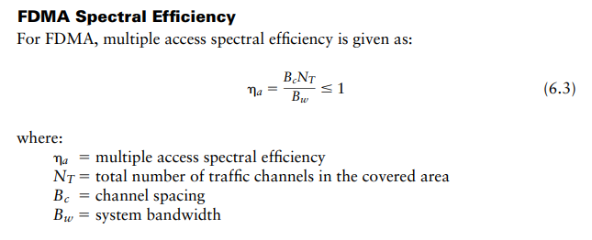
Multiple Access Spectral Efficiency

Slide 99
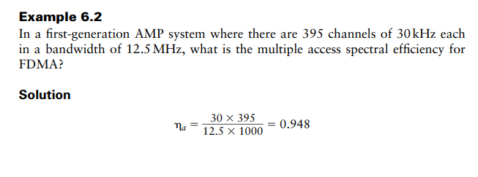
Multiple Access Spectral Efficiency

Slide 100
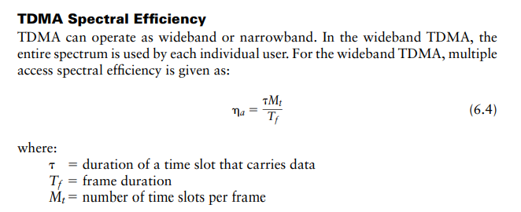
Multiple Access Spectral Efficiency

Slide 101
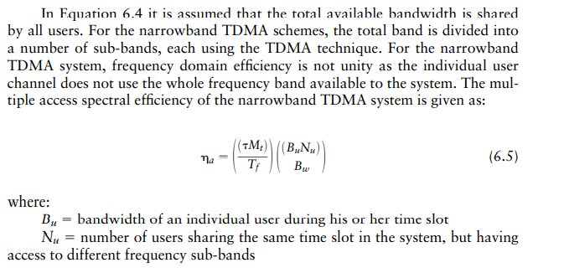
Multiple Access Spectral Efficiency(TDMA)

Slide 102
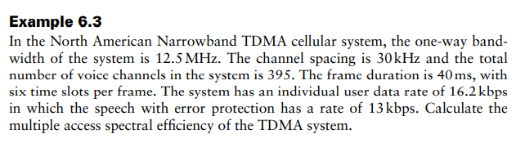
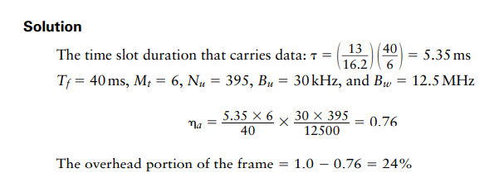

Slide 103
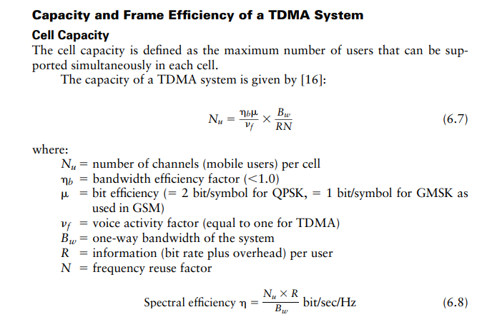

Slide 104
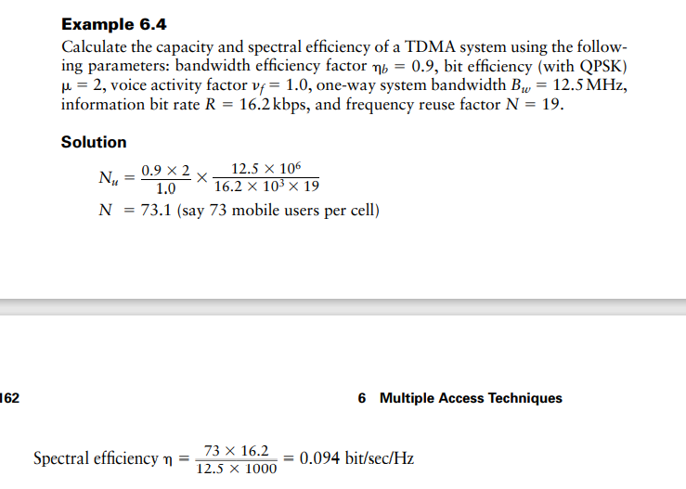

Slide 105
Spread Spectrum Multiple Access
Spread spectrum multiple access (SSMA) uses signals which have a transmission bandwidth that is greater than the minimum required RF bandwidth. A pseudo-noise (PN) sequence converts a narrowband signal to a wideband noise-like signal before transmission.
SSMA also provides immunity to multipath interference and robust multiple access capability.
SSMA is not very bandwidth efficient when used by a single user. However, since many users can share the same spread spectrum bandwidth without interfering with one another, spread spectrum systems become bandwidth efficient in a multiple user environment. It is exactly this situation that is of interest to wireless system designers.
Notes:
Spread spectrum involves the use of a much wider BW than actually necessary to support a given data rate.

Slide 106
Spread Spectrum Multiple Access Gains
SSMA provides immunity to multipath interference and robust multiple access capability.
Immunity from various noise and multipath distortion
Including jamming
Can hide/encrypt signals
Only receiver who knows spreading code can retrieve signal
Several users can share same higher bandwidth with little interference
Drastically reduce BER
So the result of using wider BW is to minimize interference and drastically reduce BER.

Slide 107
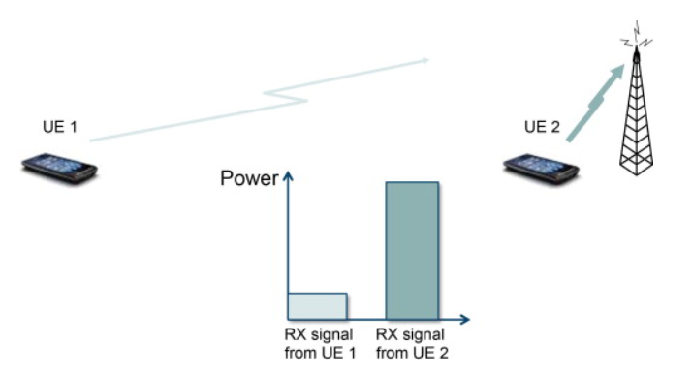
Problem
A problem can arise when the signals from different users are received at very different power levels, for example, because in the uplink one user is close to the base station whereas a second user is not, as shown in Figure.
Stronger received signal levels raise the noise floor at the base station for the weaker signals, thereby decreasing the probability that weaker signals will be received.
In this case, the spreading gain will not be able to suppress the interference from the (strong) second user’s transmission sufficiently and the reception of the first user will experience a poor signal-to-interference ratio because of interference from the second user. This problem is known as the “near-far” problem and is mitigated by the use of power control that keeps the receive power from different transmissions at appropriate levels (depending on the users’ relative data rates). Power control is provided by each base station in a cellular system and assures that each mobile within the base station coverage area provides the same signal level to the base station receiver.
Notes:
The Noise Floor is the signal created from adding up all the unwanted signals within a measurement system. The noise floor consists of noise from a number of sources which includes thermal noise, atmospheric noise and noise from components used to make the measurement system.

Slide 108
Types of Spread Spectrum Multiple Access
There are two fundamental types of spread spectrum systems:
(1) Direct Sequence Multiple Access(DSMA) and
(2) frequency hopping Multiple Access (FHMA)
Notes:
SSMA also provides immunity to multipath interference and robust multiple access capability.
The result of using wider BW is to minimize interference and drastically reduce BER.
It operates in 2.4GHz band at data rate of 1Mbps and 2Mbps.
There are two main types of spread spectrum multiple access techniques; frequency hopped multiple access (FH) and direct sequence multiple access (DS). Direct sequence multiple access is also called code division multiple access (CDMA)

Slide 109
Direct Sequence Multiple Access(DSMA)
In a DSMA system, the bandwidth of the baseband information carrying signals from a different user is spread by different codes with a bandwidth much larger than that of the baseband signals.
The spreading codes used for different users are orthogonal or nearly orthogonal to each other.
In the DSMA, the spectrum of the transmitted signal is much wider than the spectrum associated with the information rate.
At the receiver, the same code is used for despreading to recover the baseband signal from the target user while suppressing the transmissions from all other users.

Slide 110
Direct Sequence Spread Spectrum (DSSS)
Each bit represented by multiple bits using spreading code
Spreading code spreads signal across wider frequency band
In proportion to number of bits used
10 bit spreading code spreads signal across 10 times bandwidth of 1 bit code
One method:
Combine input with spreading code using XOR
Input bit 1 inverts spreading code bit
Input zero bit doesn’t alter spreading code bit
Data rate equal to original spreading code
Performance similar to FHSS

Slide 111
Direct Sequence Multiple Access(DSMA)
CDMA is a Direct Sequence Spread Spectrum system. The CDMA system works directly on 64 kbit/sec digital signals.
In CDMA, each bit time is subdivided into m short intervals called chips. Typically there are 64 or 128 chips per bit. Each station is assigned a unique m-bit chip sequence.
To transmit a 1 bit, a station sends its chip sequence.
To transmit a 0 bit, it sends the one's complement of its chip sequence.
No other patterns are permitted.
Thus for m = 8, if station A is assigned the chip sequence 00011011, it sends a 1 bit by sending 00011011 and a 0 bit by sending 11100100.

Slide 112
Direct Sequence Multiple Access(DSMA)
Increasing the amount of information to be sent from b bits/sec to mb chips/sec can only be done if the bandwidth available is increased by a factor of m, making CDMA a form of spread spectrum communication.
In order to protect the signal, the chip sequence code used is pseudo-random. It appears random, but is actually deterministic, so that the receiver can reconstruct the code for synchronous detection. This pseudo-random code is also called pseudo-noise (PN).

Slide 113
CDMA encode/decode
channel output Z_{i,m}
Z_{i,m}= d_{i}.c_{m}
data
bits
d₀ = 1
1
1
1
1
1
d₁ = -1
1
1
1
-
-
-
-
1
-
-
-
1
-
1
1
1
1
1
sender
1
1
slot 1
channel
output
slot 0
channel
output
1
1
1
1
1
code
1
1
-
-
-
1
-
1
1
1
-
-
-
1
-
1
1
1
slot 1
slot 0
M
D_{i} = Σ Z_{i,m}.c_{m}
m=1
M
received
input
1
1
1
1
1
1
1
1
d₀ = 1
-
-
-
-
1
-
-
-
1
-
1
1
1
1
1
1
d₁ = -1
1
slot 1
channel
output
slot 0
channel
output
1
1
1
1
1
code
1
1
-
-
-
1
-
1
1
1
-
-
-
1
-
1
1
1
receiver
slot 1
slot 0

Slide 114
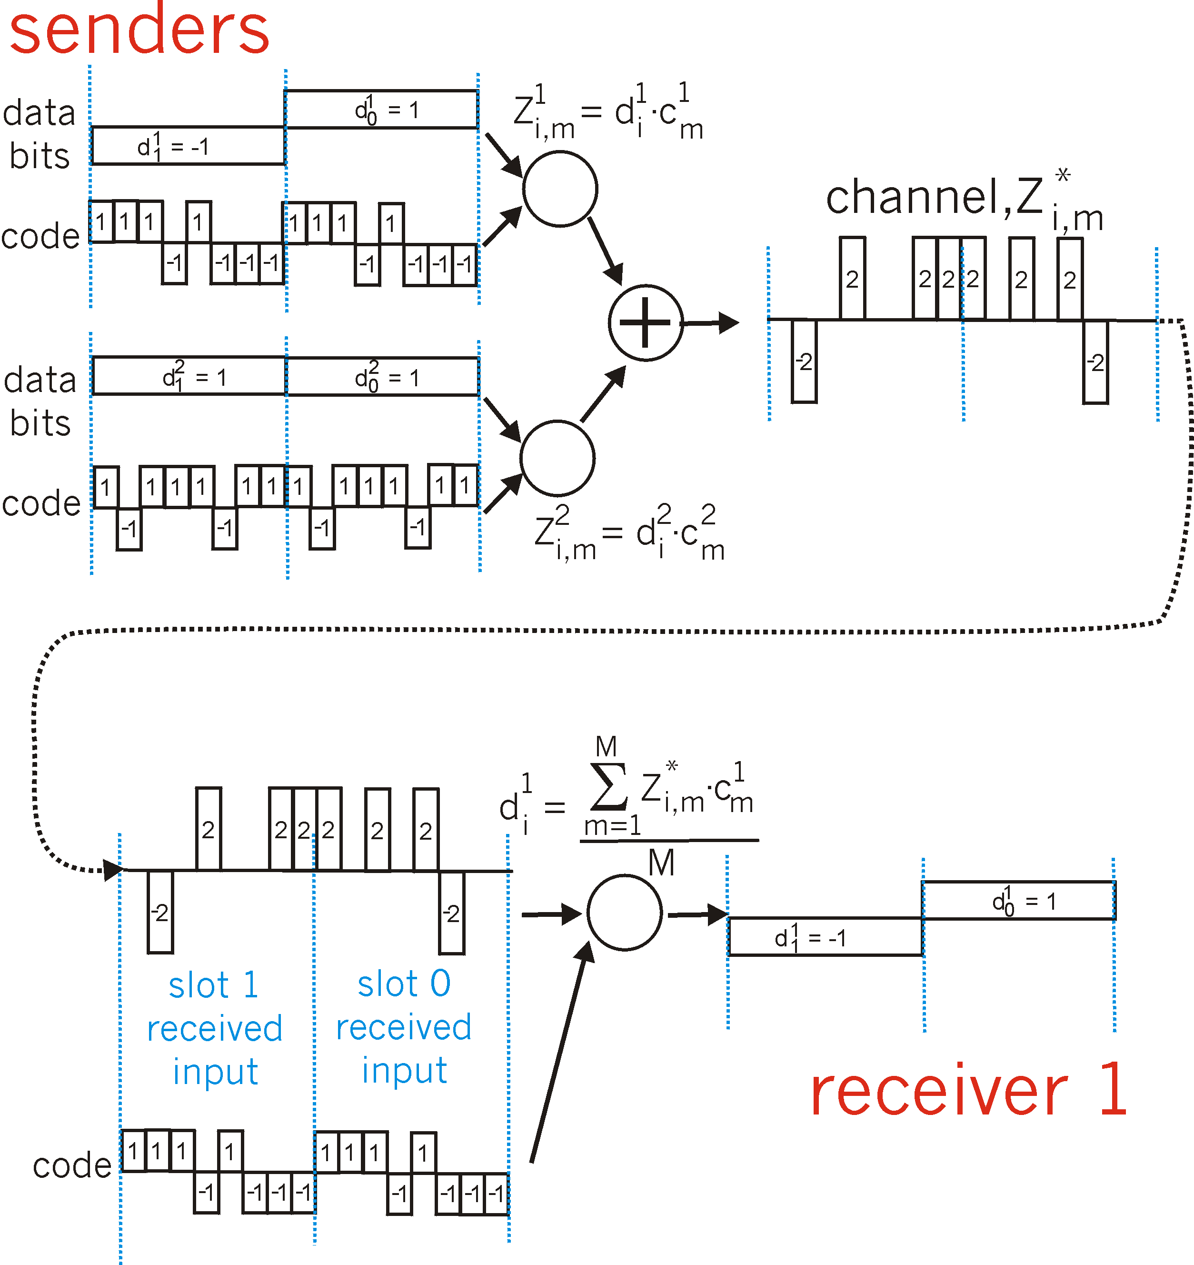
CDMA: two-sender interference
channel sums together transmissions by sender 1 and 2
Sender 1
Sender 2
using same code as sender 1, receiver recovers sender 1’s original data from summed channel data!

Slide 115
Frequency Hopped Multiple Access (FHMA)
Frequency hopped multiple access (FHMA) is a digital multiple access system in which the carrier frequencies of the individual users are varied in a pseudorandom fashion within a wideband channel.
The digital data is broken into uniform sized bursts which are transmitted on different carrier frequencies.
The instantaneous bandwidth of any one transmission burst is much smaller than the total spread bandwidth.
The pseudorandom change of the carrier frequencies of the user randomizes the occupancy of a specific channel at any given time, thereby allowing for multiple access over a wide range of frequencies.
In the FH receiver, a locally generated PN code is used to synchronize the receivers instantaneous frequency with that of the transmitter.

Slide 116
Frequency Hopped Multiple Access (FHMA)
The difference between FHMA and a traditional FDMA system is that the frequency hopped signal changes channels at rapid intervals.
A frequency hopped system provides a level of security, especially when a large number of channels are used, since an unintended (or an intercepting) receiver does not know the pseudorandom sequence of frequency slots
In addition, the FH signal is somewhat immune to fading. In case of FHSS, spread spectrum is achieved by frequently jumping from one carrier frequency to another; thus if there is interference or performance degradation at a given frequency, it only affects a small fraction of transmission.
The amount of time spent at each frequency, the dwell time, is an adjustable parameter but must be less than 400 ms.
Operates at 2.4 GHz band at data rate of 1Mbps and 2Mbps

Slide 117
Frequency Hopped Multiple Access (FHMA)
Types of frequency hopping are:
(I) Slow frequency hopping
(2) Fast frequency hopping
Slow-frequency hopping- In slow frequency hoping several symbols are transmitted corresponding to each frequency hopping. Therefore each frequency hopping several symbols i.e. frequency hopping takes place slowly.
Fast frequency hopping- In the fast frequency hopping during the transmission of one symbol, the carrier frequency will hop several times. Therefore each symbol transmission several frequencies hops. Thus- the frequency hopping takes place at a fast rate.

Slide 118
Spreading Sequences
Spreading sequences are very important in the design of spread spectrum communication
Two categories of Spreading Sequences
PN sequences
Orthogonal codes
FHSS systems
PN sequences most common
DSSS CDMA systems
PN sequences
Orthogonal codes

Slide 119
PN Sequences
PN sequences are periodic but appear random within one period
PN sequences are very easy to generate
Generated using LFSR
PN sequences are easy to re-generate and synchronize at the receiver
PN sequences have good random properties
linear-feedback shift register - LFSR

Slide 120
Linear-feedback shift register
A linear-feedback shift register (LFSR) is a shift register whose input bit is a linear function of its previous state.
The most commonly used linear function of single bits is exclusive-or (XOR). Thus, an LFSR is most often a shift register whose input bit is driven by the XOR of some bits of the overall shift register value.
The initial value of the LFSR is called the seed, and because the operation of the register is deterministic, the stream of values produced by the register is completely determined by its current (or previous) state. Likewise, because the register has a finite number of possible states, it must eventually enter a repeating cycle. However, an LFSR with a well-chosen feedback function can produce a sequence of bits that appears random and has a very long cycle.

Slide 121
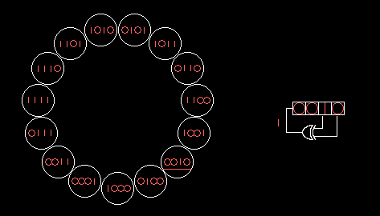
Linear-feedback shift register
A 4-bit Fibonacci LFSR with its state diagram. The XOR gate provides feedback to the register that shifts bits from left to right.

Slide 122
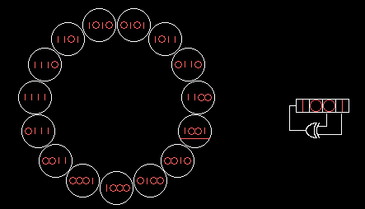
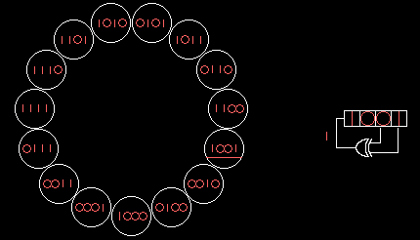
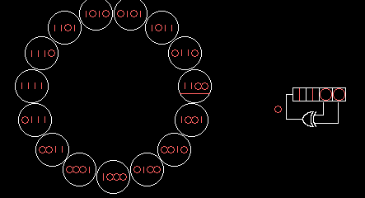
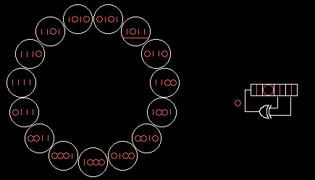
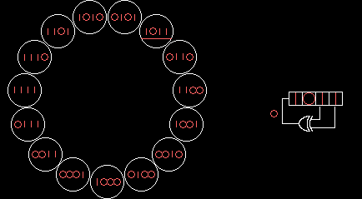
Linear-feedback shift register
A 4-bit Fibonacci LFSR with its state diagram. The XOR gate provides feedback to the register that shifts bits from left to right.

Slide 123
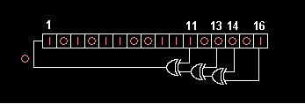
Linear-feedback shift register
16-bit Fibonacci LFSR

Slide 124
Thank You

